Slide 1
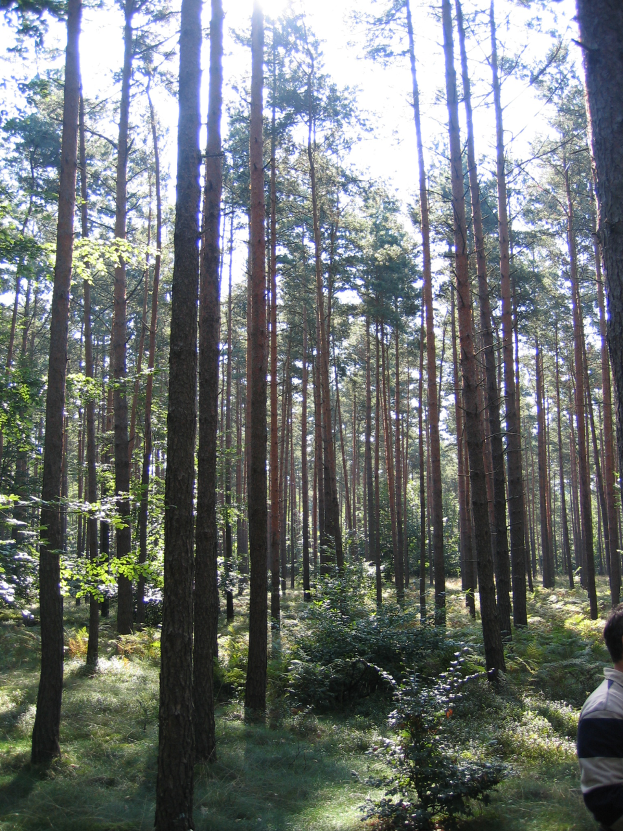
Levels, Spatial Distribution and Fingerprints of POPs in German forest soils
PAH, PCB, DDx, HCB, HCH, xDrine, PCDD/F, Endosulfan
Bernd M Bussian
UBA – Umweltbundesamt
Federal Environment Agency

Slide 2
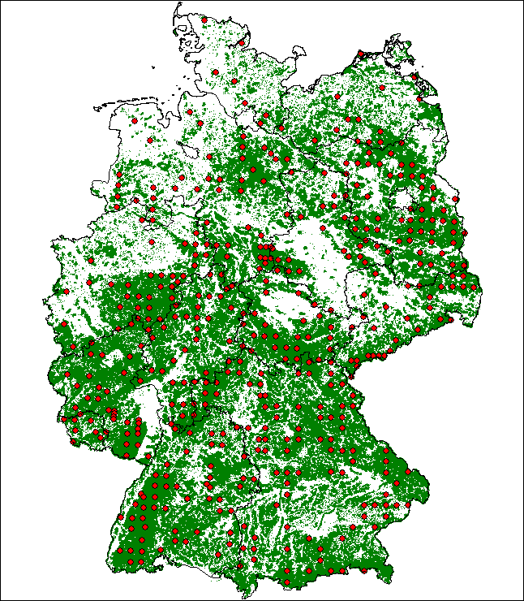
Second German Forest Soil Inventory BZE II
Sampling 2006 -2007
Total area 357,000 km²
A third of the total area covered by forests i.e. 111,000 m²
Arable land about 50 %
Fraction of forest areas varies in the German states between 3 % and 64 %
EU Forests Focus/BIOSOIL
grid of 16 km x 16 km
(BZE Sampling:
systematic grid of 8 km x 8 km)

Slide 3
The aim of this study
Role of soil as sink and source for pollutants
Quantify the historical burden of POP emissions
Efficacy of measures on POPs
Evaluate a concise operation procedure and a monitoring strategy for POPs in soils

Slide 4
BZE Organics – main study
477 plots x 3 soil layers / horizons
1.431 samples + 300 QC samples
→ 1.731 samples
→ 34 analytes (LOQ ~ 1 ng / g d.m.)
16 PAH (EPA)
6 indicator PCBs
HCH
HCB
Aldrin / Dieldrin
DDx
60,000 analytical data
+ additional information of sampling sites

Slide 5
BZE Organics – extended study
86 plots x 1 soil layer / Humic top soil
86 samples + QC samples
Halogented organic pollutants (LOQ ~ 1 pg/g d.m.)
Aldrine, Dieldrine, Endrine
Heptachlor, Chlordane
Penta-, Hexachlorbenzene
HCH
Mirex
DDT, DDD, DDE
PCB (ndl´s & dl´s)
Dioxines, Furanes
PBDE
Endosulfan

Slide 6
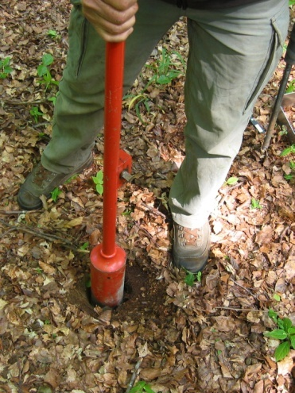
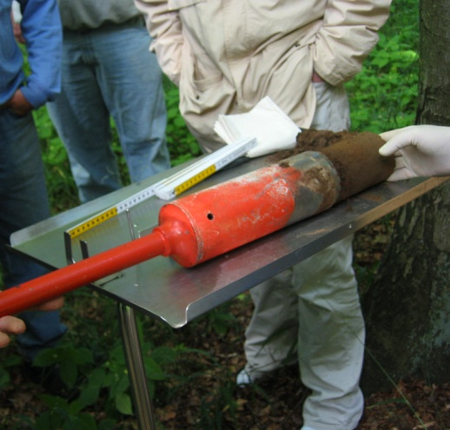
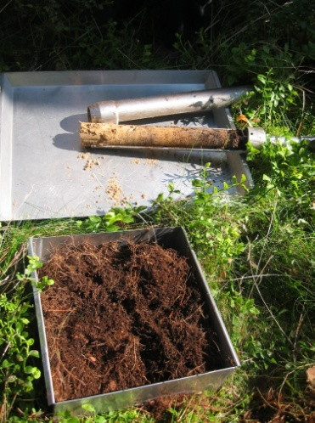
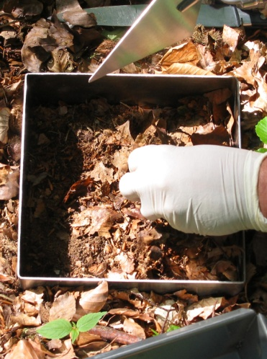
Sampling

Slide 7
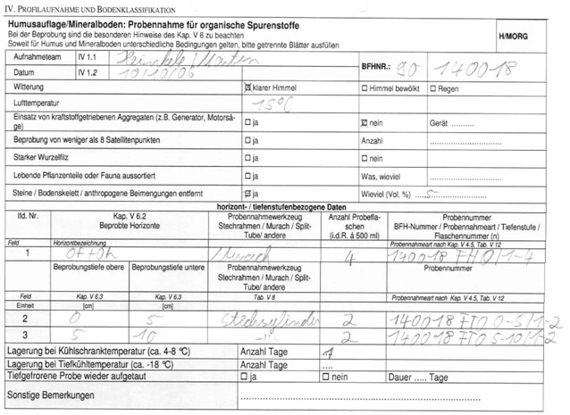
Sampling

Slide 8
Sampling
Detailed reporting is a must

Slide 9
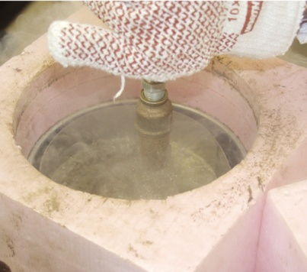
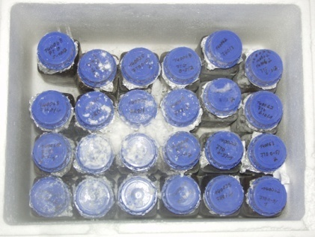
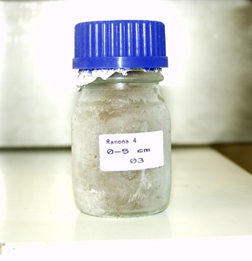
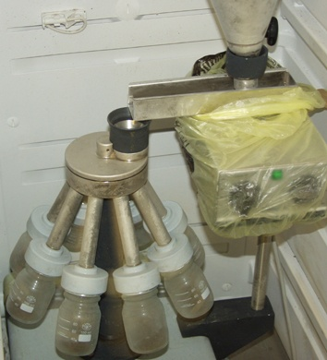
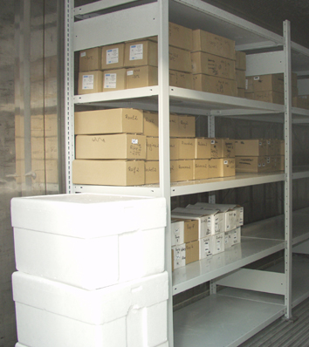
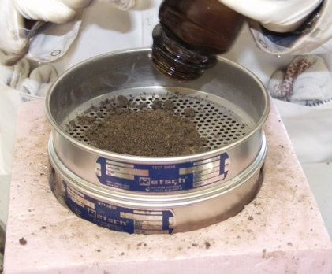
Sample Pretreatment

Slide 10
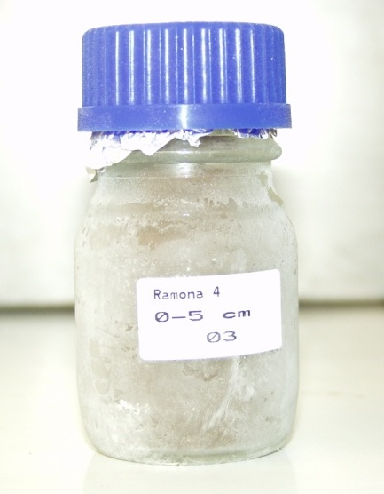
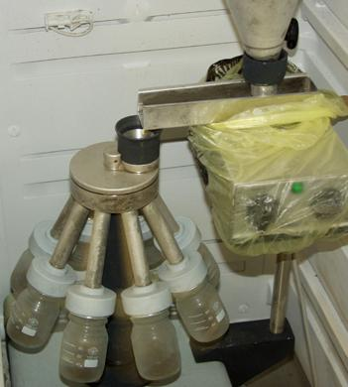
Sample Pretreatment

Slide 11
The Data Set BZE Organics
Basic statistics of location parameters of 447 sampling spots
 | altitude [m] | slope [°] | soil pH | TOC [%] | MAP [mm] | MST [°C] | MWT [°C]
Min | 3.0 | 0.0 | 2.6 | 4.8 | 491.3 | 12.5 | -3.5
10% | 43.4 | 0.0 | 3.1 | 28.0 | 580.0 | 15.1 | -1.0
50% | 348.0 | 5.0 | 3.9 | 37.4 | 833.5 | 16.7 | 0.7
Mean | 344.9 | 8.3 | 4.1 | 36.6 | 876.8 | 16.6 | 0.5
90% | 668.4 | 23.7 | 5.3 | 44.2 | 1,202.2 | 17.9 | 1.7
Max | 1,280.0 | 55.0 | 6.4 | 49.2 | 2,231.5 | 19.1 | 3.5

Slide 12
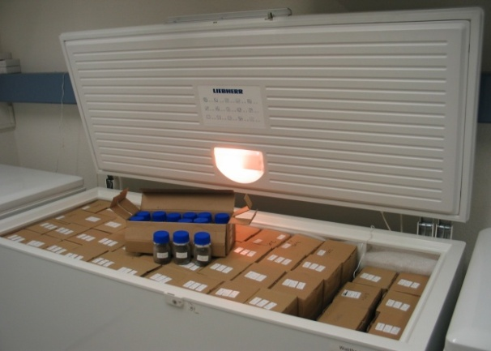
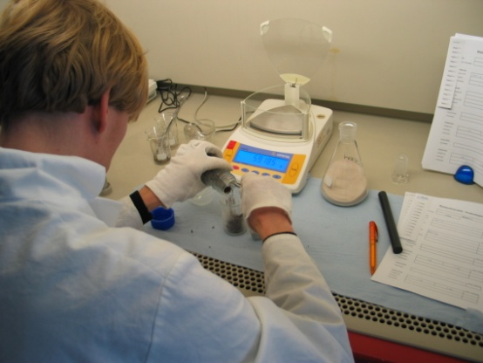
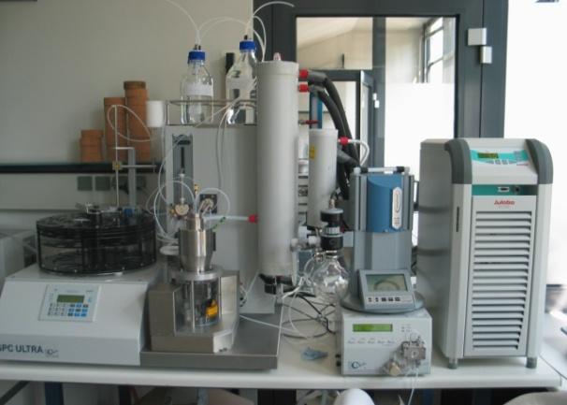
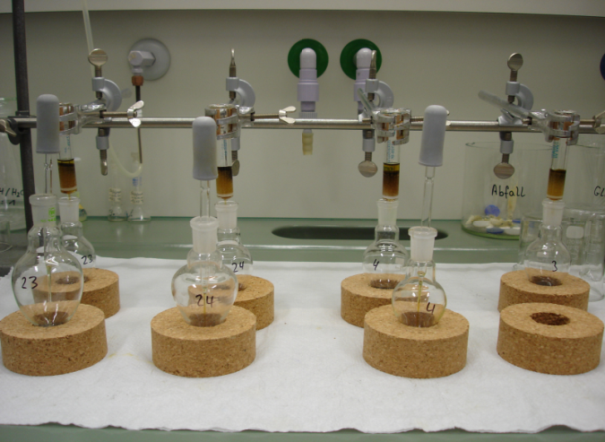
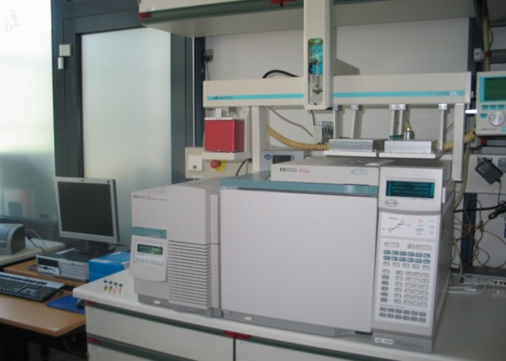
Analytics
Sample storage
subsampling
ASE
GPC
SPE
GC-HRMS

Slide 13
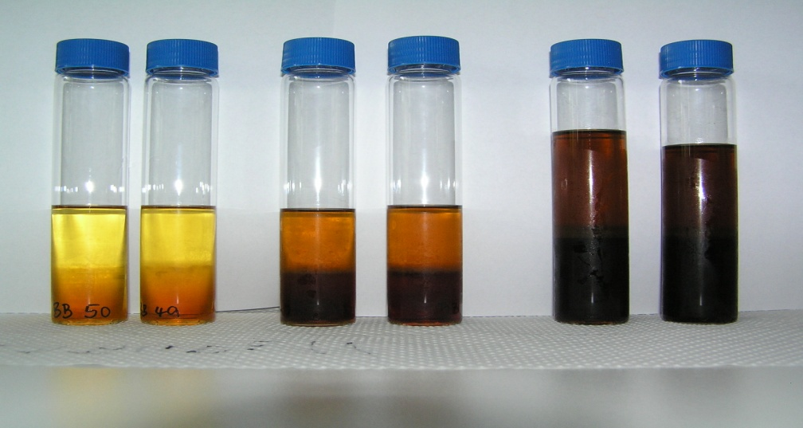
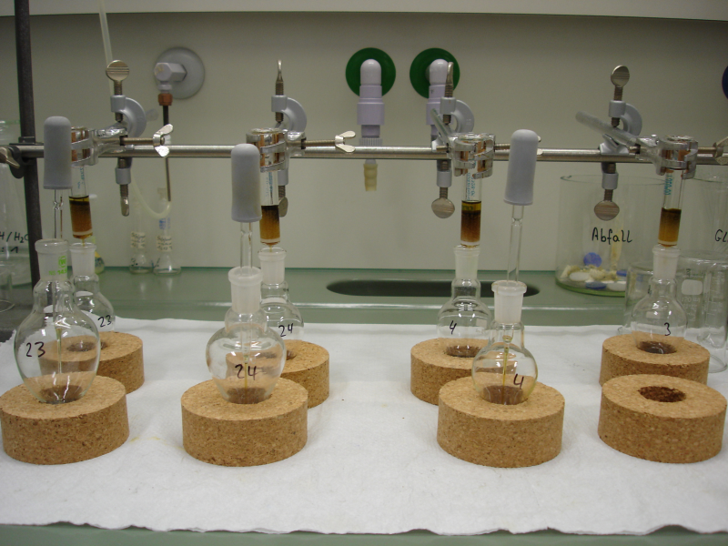
ASE-Extrakte
Clean-up of ASE extracts
Extracts after ASE extraction
Gel-Permeation-Chromatography (GPC)

Slide 14
Results BZE (top soil – humic layer)
Basic statistical parameters of measured POP-contents in 447 samples
All data as ng/g d.m.
lmwPAH: PAHs with 2 or 3 aromatic rings
hmwPAHs: PAHs with 4. 5 and 6 aromatic rings without Fla and Pyr
 | ∑16 PAH | ∑lmw PAH | ∑Fla+Pyr | ∑hmw PAH | ∑6-PCB | ∑DDx | Dieldrin | HCB
Min | 104.6 | 22.2 | 22.1 | 44.4 | 0.5 | 0.8 | 0.0 | 0.0
10% | 283.1 | 57.8 | 76.0 | 142.3 | 4.2 | 4.2 | 0.0 | 1.0
50% | 1,447.9 | 171.8 | 361.2 | 803.2 | 13.6 | 31.3 | 2.7 | 3.0
Mean | 2,098.1 | 353.1 | 534.2 | 1,210.8 | 18.2 | 146.3 | 2.7 | 3.7
90% | 4,935.3 | 845.0 | 1,215.9 | 2,759.0 | 35.9 | 291.5 | 5.4 | 7.4
Max | 14,889.0 | 4,424.1 | 5,053.9 | 8,613.4 | 106.3 | 4,382.7 | 12.0 | 23.5

Slide 15
Results BZE (top soil – humic layer)
Basic statistical parameters of measured POP-contents in 447 samples
All data as ng/g d.m.
 | α−HCH | β−HCH | γ−HCH | ΣHCH | Aldrine | Dieldrine | Endrine | HCB
Min | 0.0 | 0.0 | 0.0 | 0.0 | 0.0 | 0.257 | 0.0 | 0.0
10% | 0.0 | 0.0 | 0.0 | 0.0 | 0.0 | 0.617 | 0.0 | 0.0
50% | 1.4 | 0.0 | 4.6 | 5.9 | 0.019 | 2.203 | 0.037 | 0.048
Mean | 4.6 | 4.5 | 7.9 | 15.9 | 0.050 | 3.051 | 0.049 | 0.061
90% | 5.0 | 7.1 | 14.5 | 22.1 | 0.161 | 5.581 | 0.099 | 0.117
Max | 991.2 | 721.0 | 163.4 | 1,875.6 | 0.365 | 27.583 | 0.618 | 0.505

Slide 16
Results BZE (top soil – humic layer)
Basic statistical parameters of measured POP-contents in 447 samples
All data as pg/g d.m.
 | α−Endosulfan | β−Endosulfan | Endosulfan-Sulfate | Σendo-sulfan | PCB TEQ05 | PCDD/F TEQ05
Min | 24.4 | 0.00 | 0.00 | 99.1 | 0.78 | 2.19
10% | 56.1 | 136.6 | 4,407 | 4856.6 | 2.05 | 3.67
50% | 136.0 | 368.8 | 13,071 | 1,3662 | 8.46 | 16.94
Mean | 189.8 | 550.6 | 17,810 | 18,550 | 9.52 | 20.52
90% | 373.2 | 948.5 | 34,662 | 35,879 | 16.71 | 39.25
Max | 1225.4 | 5904.2 | 130,358 | 132,642 | 40.47 | 105.46

Slide 17
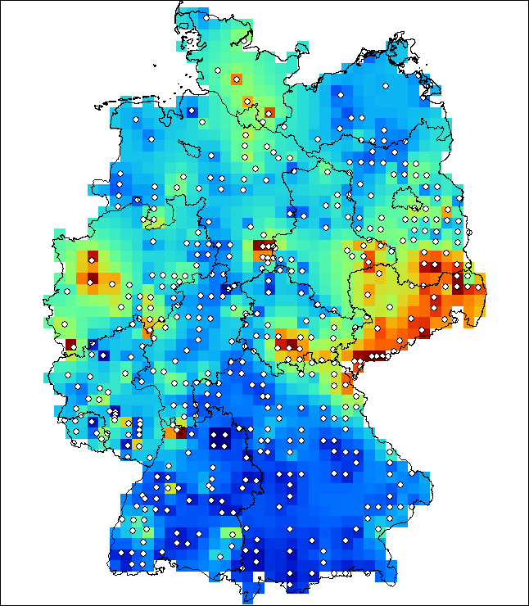
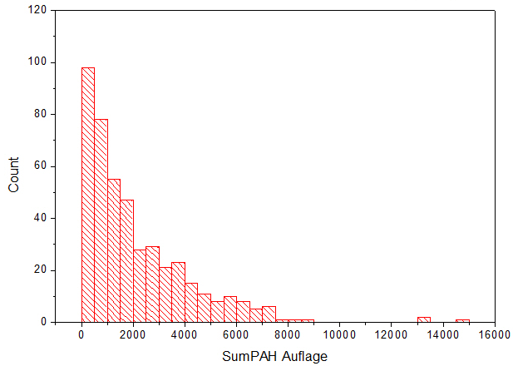
Results - PAH
90% Percentile [ng / g d.w.]
Humic layer (O-Horizon) (ng/g dm)

Slide 18
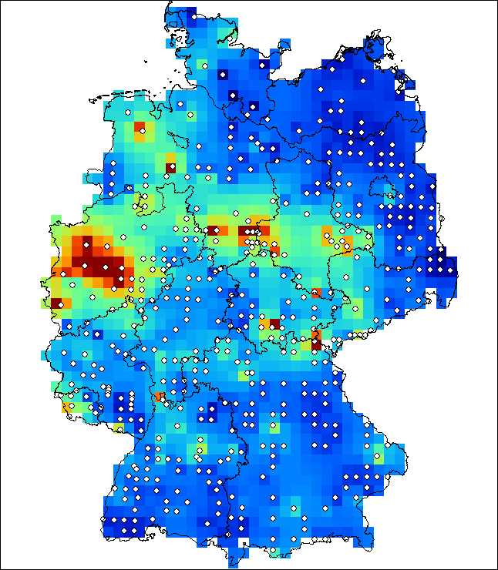
Results - PAH
Humic layer (O-Horizon) (ng/g dm)
Mineral soil (0-5 cm) (ng/g dm)

Slide 19
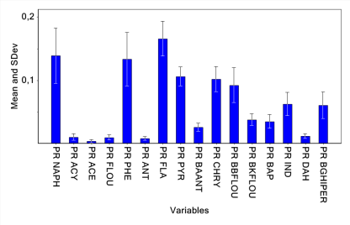
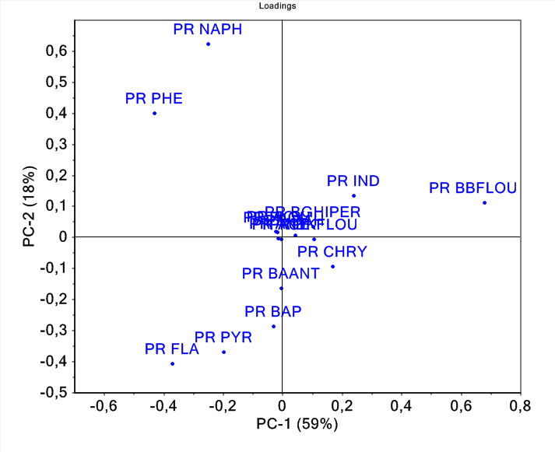
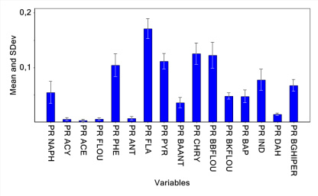
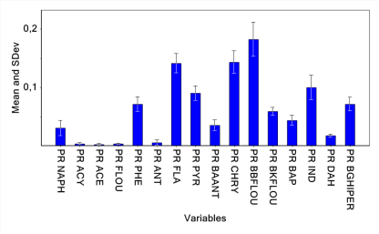
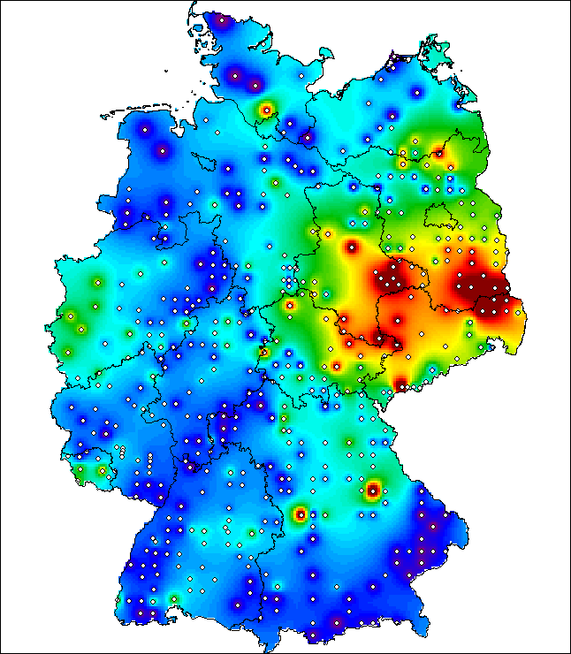
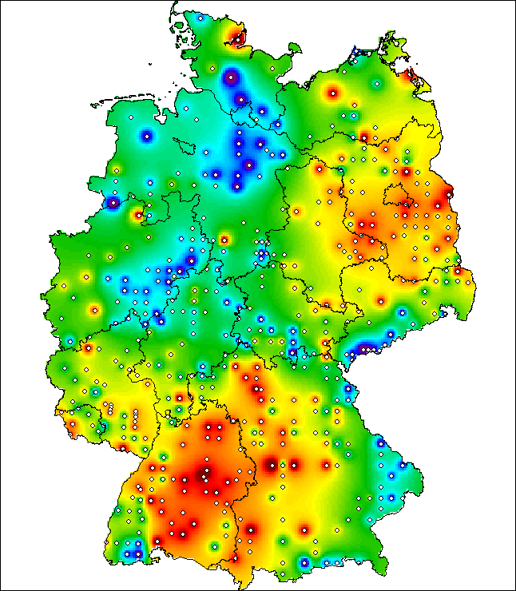
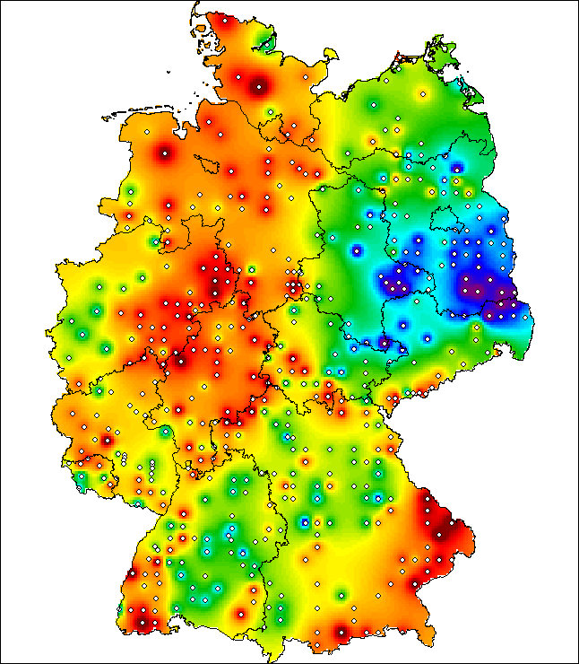
Results - PAH
%
+
-
Phenanthren
Flouranthen
Benzo(b)flouranthen

Slide 20
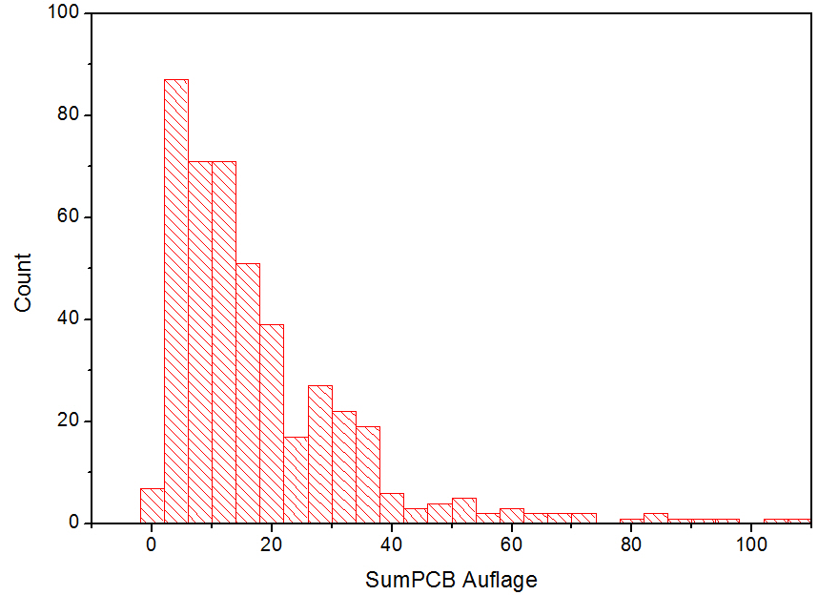
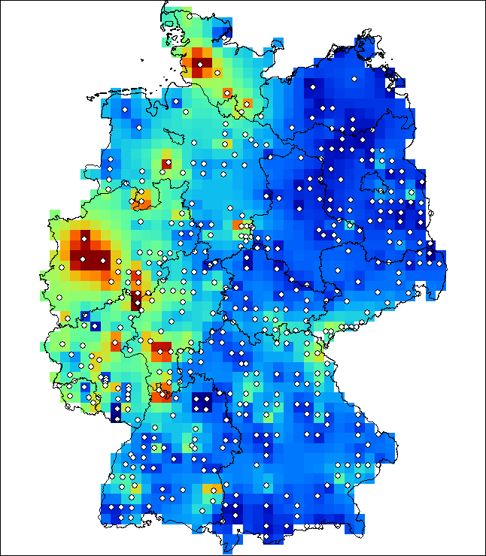
Results – indicator PCB
90% Perzentil
Humic layer (O-Horizon) (ng/g dm)

Slide 21
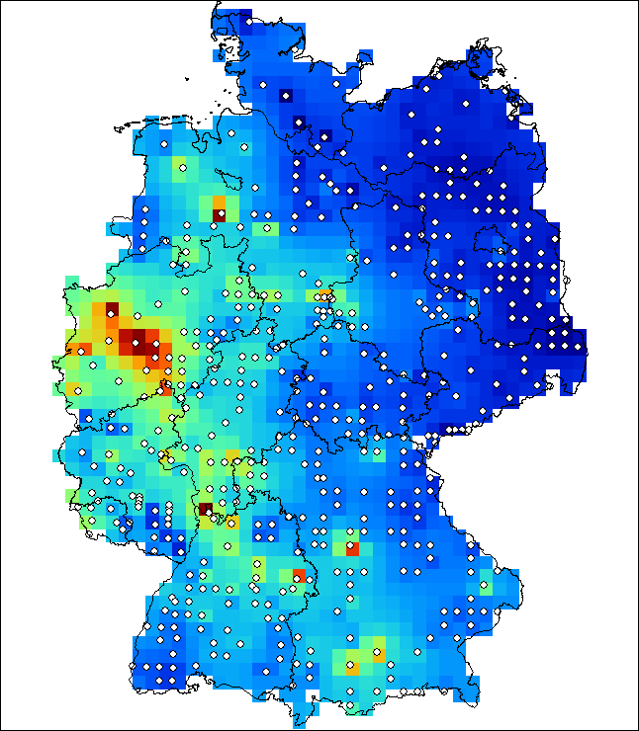
Results – indicator PCB
Humic layer (O-Horizon) (ng/g dm)
Mineral soil (0-5 cm) (ng/g dm)

Slide 22
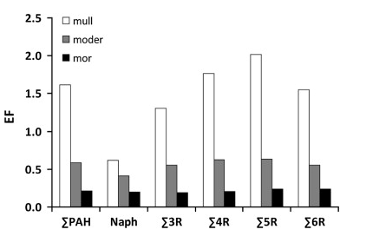
Dependence on Humus Types

Slide 23
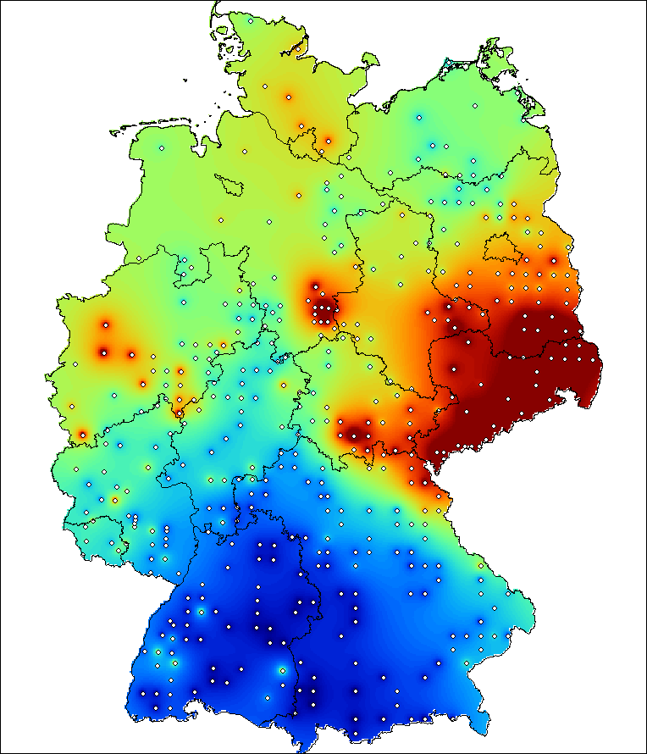
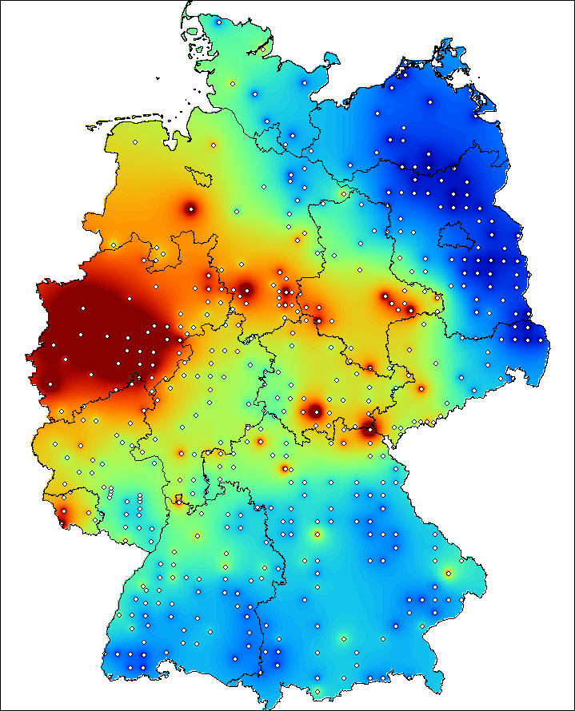
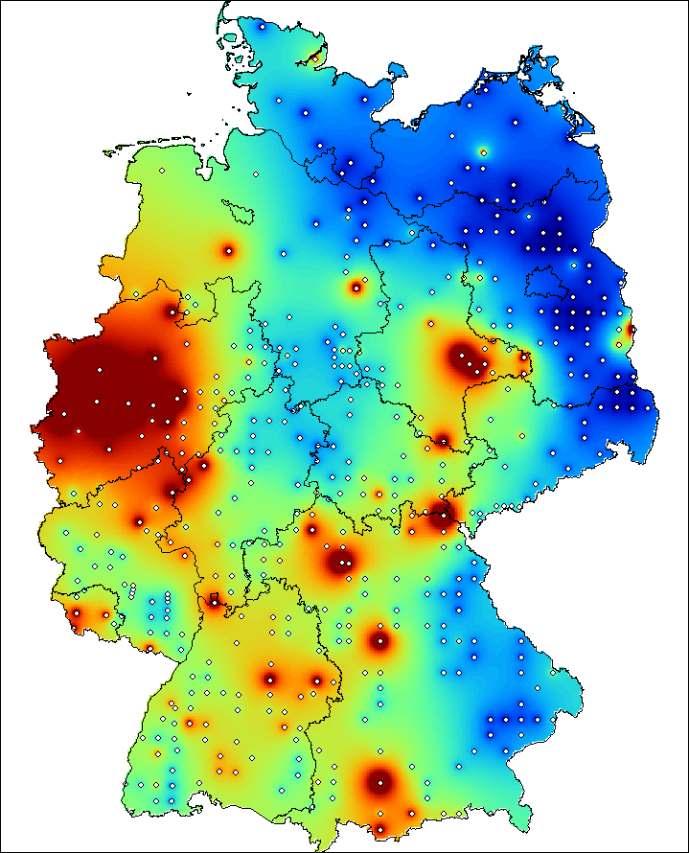
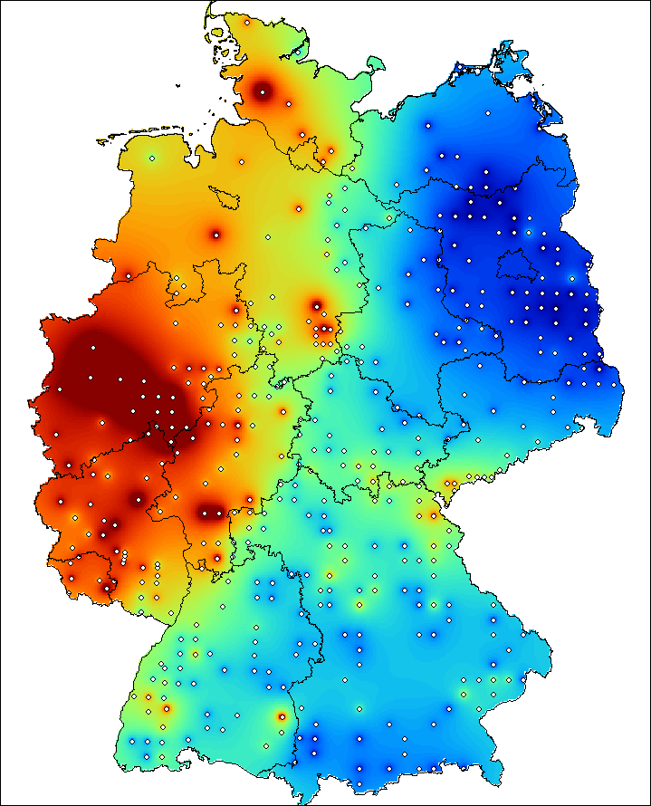
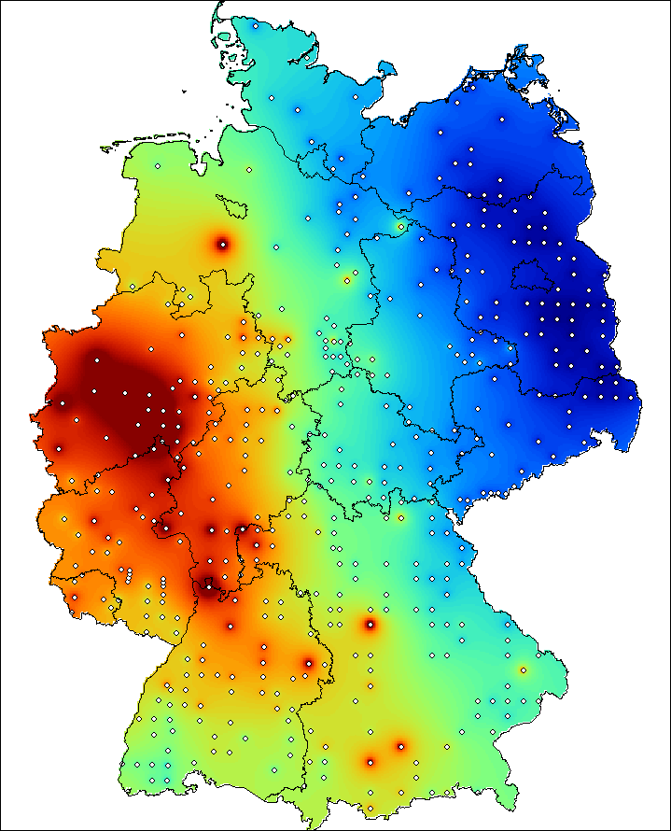
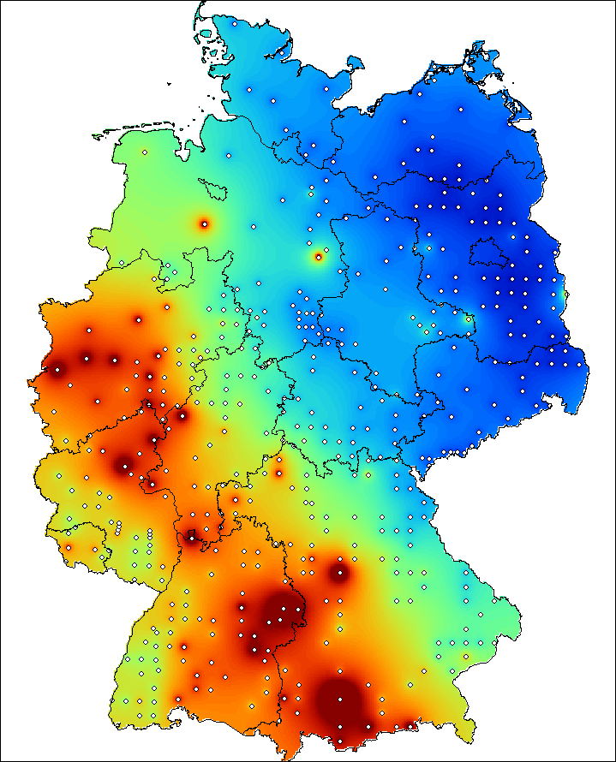
Dispersion of PAHs and PCBs
Humic layer
0-5 cm
5-10 cm
PAHs:
PCBs:

Slide 24
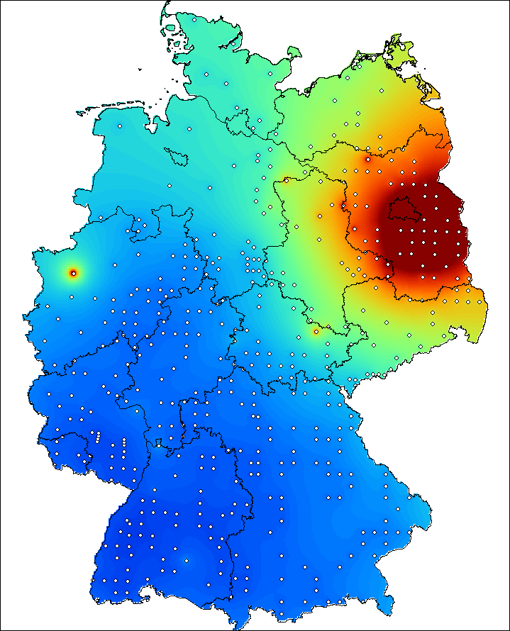
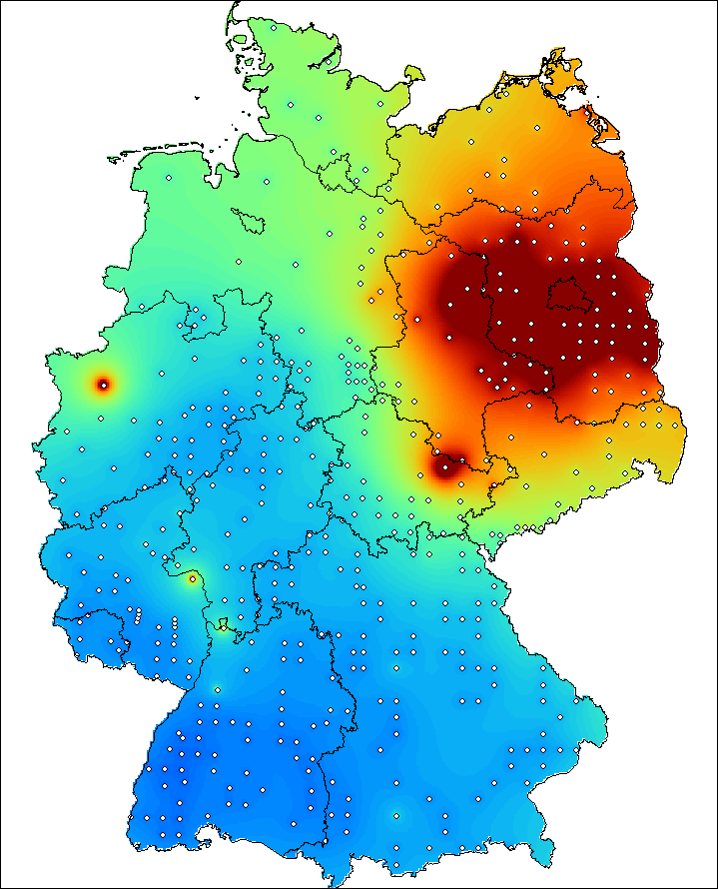
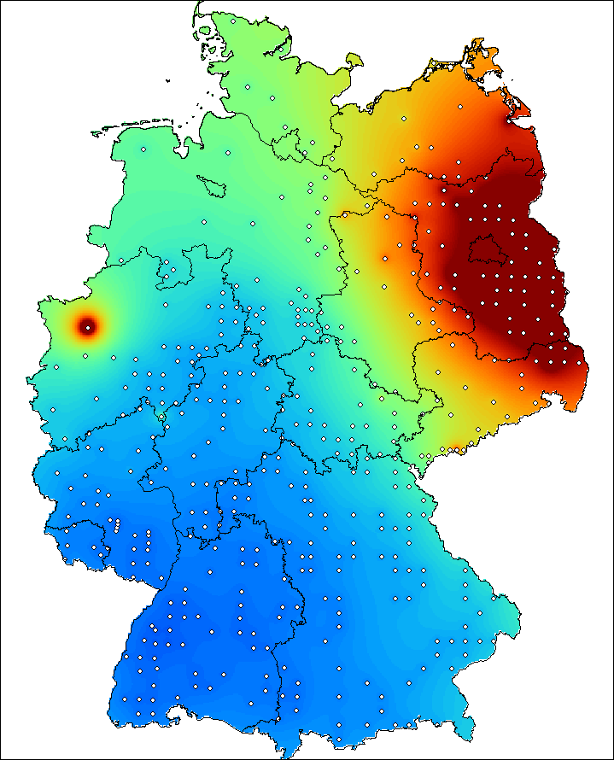
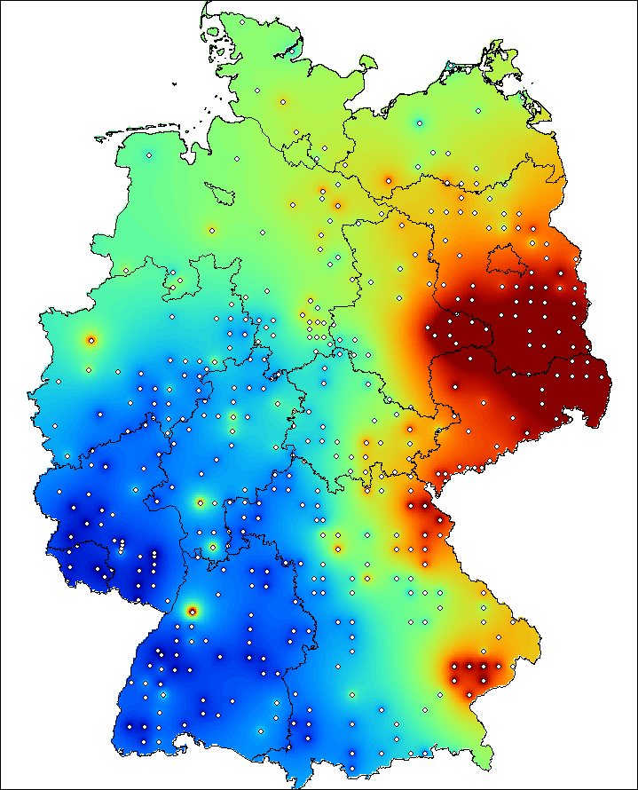
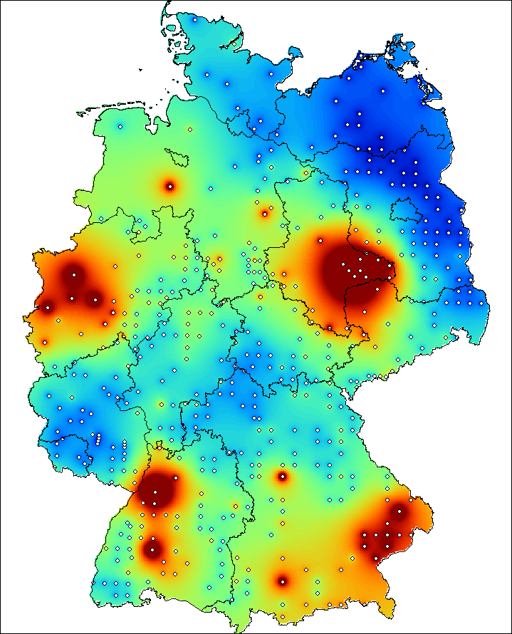
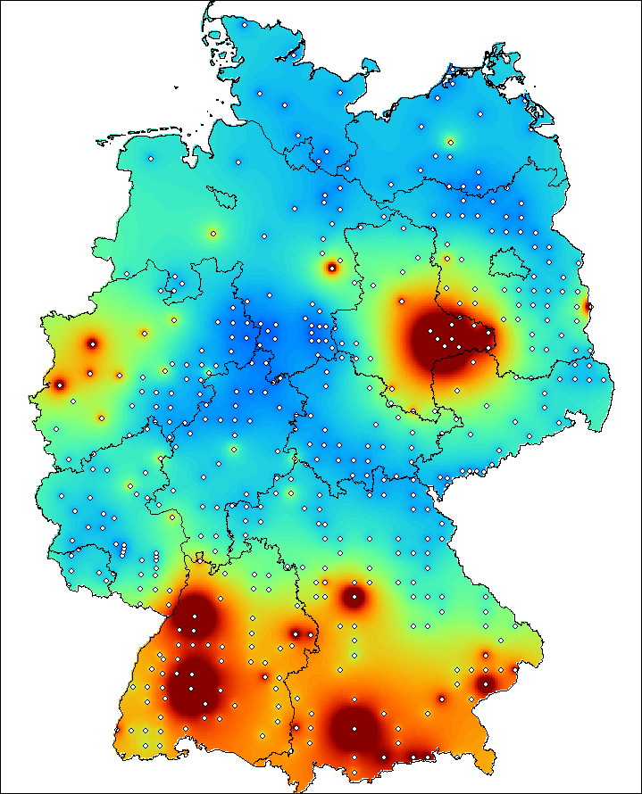
Dispersion of DDX and HCB
Humic layer
0-5 cm
5-10 cm
DDx:
HCB:

Slide 25
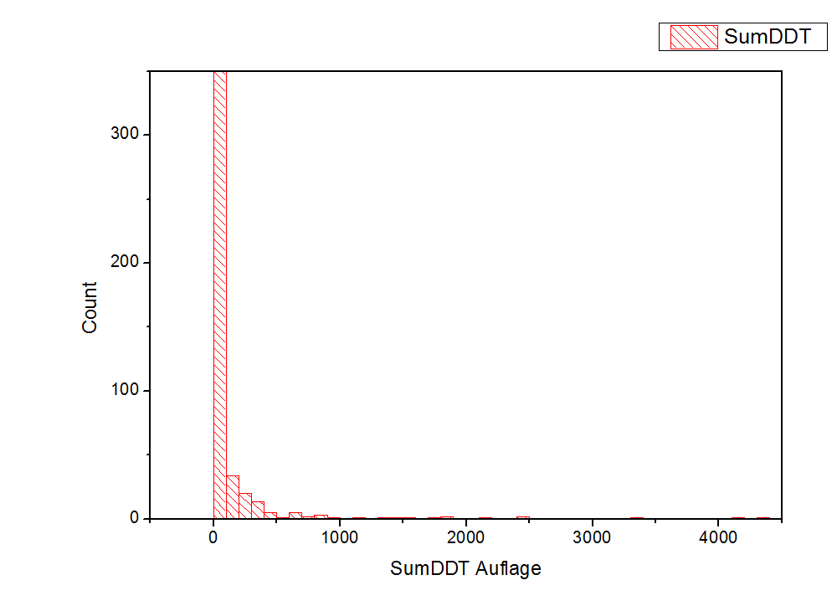
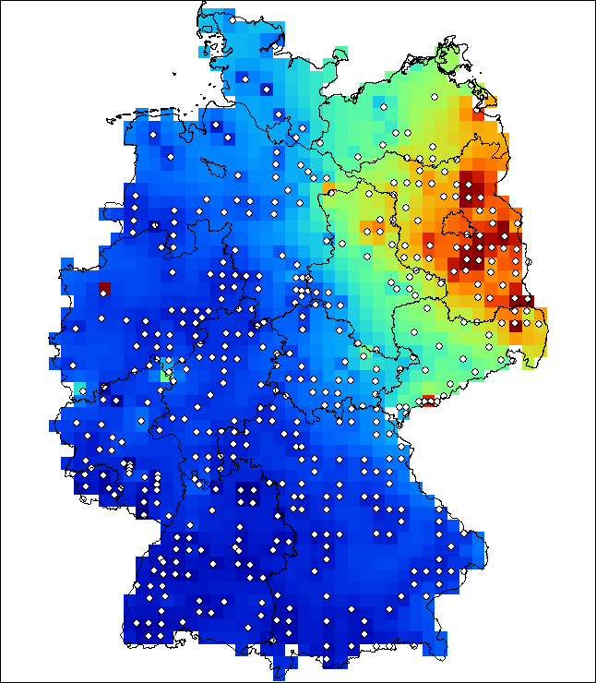
Results - DDx
90% Perzentil (in ng/g TM)
Humic layer (O-Horizon) (ng/g dm)

Slide 26
Results - DDx
Humic layer (O-Horizon) (ng/g dm)
Mineral soil (0-5 cm) (ng/g dm)

Slide 27
Results - DDx
DDT consumption for agri-/silvicultûral use in GDR
DDx found in the lipid fraction of porc meet (district of Schwerin)

Slide 28
Results - DDx
Technical DDT 4,4‘-DDT: ca. 80%
2,4‘-DDT: ca. 15%
4,4‘-DDE: ca. 4%
Aerobic metabolism
Anaerobic metabolism
DDT
DDE
DDD
Content ∑DDx
Fraction of 4,4‘ – DDE in ∑DDx

Slide 29
Results - Aldrine

Slide 30
Correlation of the Drines

Slide 31
From concentrations to stocks
determine the stocks of substances in soil
Content X bulk density (mass of substance per volume) X thickness
ng / g X g / cm³ X cm

Slide 32
Stocks (mineral soil)
Soil stock (as tons / ha)
Humic layer mineral soil 0 – 5 cm mineral soil 0 – 5 cm

Slide 33
Results Indicator PCBs
PCB6 | Humic layer [ng/g] | stock [g/sqm] | mineral soil 0-5 cm [ng/g] | stock [g/sqm] | mineral soil 5-10 cm [ng/g] | stock [g/sqm]
Min | 0 | 0 | 0 | 0 | 0 | 0
Mean | 17 | 0.00010 | 4 | 0.00014 | 1 | 0.00006
Median | 13 | 0.00003 | 3 | 0.00009 | 1 | 0.00003
Max | 106 | 0.00186 | 45 | 0.00159 | 27 | 0.00132
Span | 106 | 0.00186 | 45 | 0.00159 | 27 | 0.00132

Slide 34
Results dl-PCB and TCDD/F [pg WHO-TEQ / g d.w.]
dl-PCB
TCDD/F

Slide 35
Results total loads of PCBs and Dioxins found in german forest soils
 | Mean Stock PCDDF (TEQ) | Mean Stock dl-PCB | Load PCDDF (TEQ) | Load dl-PCB | load dl-PCB + PCDDF
 | ng TEQ / m2 | ng TEQ / m2 | kg TEQ | kg TEQ | kg TEQ
"old" states |  |  | 8,0 | 3,8 | 11,9
"new" states |  |  | 4,7 | 2,0 | 6,6
Mean | 131,8 | 66,9

Slide 36
Conclusions
Qualitative and quantitative requirements
Harmonized sampling
(SOPs, standards, sampling by depth, sampling by horizons)
Standardized and validated analytical procedures
(QA/QC, LOQ, repeatibility, reproducibility, traceability, ...)
Be aware of the experimental uncertainty

Slide 37
Conclusions
State of the art methods
Concentrations and stocks
Analytical accuracy allows to analyze metabolites, non-target compounds, emerging pollutants, …
Do not aggregate data at an early evaluation level
Validate models by experimental data

Slide 38
Conclusions
Qualitative and quantitative requirements
Evaluate concentrations / contents and stocks
Data on soils physics are needed (density, sampling depth, thickness of horinzons, humidity, Corg, texture, etc.)
Be as accurate as the lowest assessment value
Outliers – they do not exist in reality

Slide 39
Conclusions
Harmonization of soil monitoring in Europe
Spatial heterogenity of soils asks for a systematic and stratified soil sampling
Sampling procedures need to be harmonized
Learn from previous monitoring studies (national, regional, EU-wide, …)
A momentum is needed for an EU-wide soil survey

Slide 40
Sampling bfh-web.fh-eberswalde.de/bze/upload/Arbeitsanleitung/Arbeitsanleitung.zip Arbeitsanleitung für die zweite bundesweite Bodenzustandserhebung im Wald (BZE II) www.ti.bund.de/no_cache/en/startseite/institutes/forest-ecosystems/research-projects/national-soil-survey/about.html Analytical method Soils Sediments (2010) 10. 1487–1498 Multi-residue analysis of PAH. PCB. and OCP optimized for organic matter of forest soil. P Lehnik-Habrink, S Hein, T Win, W Bremser, I Nehls
Papers

Slide 41
Environ. Sci. Technol. (2013) 47, 12703−12714 Levels and Spatial Distribution of Persistent Organic Pollutants in the Environment: A Case Study of German Forest Soils B Aichner, B M Bussian, P Lehnik-Habrink, S Hein Environmental Pollution (2015) 203, 31–39 Regionalized concentrations and fingerprints of polycyclic aromatic hydrocarbons (PAHs) in German forest soils B Aichner, B M Bussian, P Lehnik-Habrink, S Hein submitted Persistent endosulfan sulfate is found with highest abundance among endosulfan I. II. and sulfate in German forest soils B M Bussian, M Pandelova, P Lehnik-Habrink, B Aichner, B Henkelmann, K-W Schramm
Papers

Slide 42
Thanks go to our collaborators
Many thanks for your attention

